Slide 1
Digital Portfolio
STUDENT NAME : ABUBAKKAR SITHIK N
REGISTER NO AND NMID :7DA8038D914CF43A1464507398A8683F
DEPARTMENT :COMPUTER SCIENCE
COLLEGE: COLLEGE/ UNIVERSITY :GOVERNMENT ARTS AND SCIENCE COLLEGE
METTUPALAYAM/BHARATHIAR UNIVERSITY

Slide 2
PROJECT TITLE
MY DIGITAL PORTFOLIO

Slide 3

PROBLEM STATEMENT
Students and fresh developers often struggle to showcase their skills and projects beyond a resume.
A personal portfolio website solves this problem by providing a central place to present projects, skills, and contact information in an interactive way.

Slide 4


AGENDA
Problem Statement
Project Overview
End Users
Tools and Technologies
Portfolio design and Layout
Features and Functionality
Results and Screenshots
Conclusion
Github Link
3/21/2024 Annual Review

Slide 5

PROJECT OVERVIEW
This project is a personal portfolio website for Abubakkar Sithik (B.Sc. Computer Science student).
It showcases skills, interests, and projects in web development and electronics.
The site is designed to be clean, responsive, and easy to navigate.

Slide 6

WHO ARE THE END USERS?
Recruiters and hiring managers looking to evaluate skills
College professors and peers reviewing academic projects
Freelance clients seeking proof of web development ability
General audience interested in student’s work and interests

Slide 7

TOOLS AND TECHNIQUES
HTML5, CSS3 (Flexbox, Grid)
JavaScript (ES6+)
EmailJS (for contact form)
GitHub (code hosting)
Sublime text editor Code (development)
Responsive design techniques

Slide 8
POTFOLIO DESIGN AND LAYOUT
Sticky header with navigation
Hero section with intro & quick links
About section with profile photo + bio
Skills and Interests as interactive chips
Projects section with code viewer
Contact form integrated with EmailJS
Light/Dark theme toggle
8

Slide 9
FEATURES AND FUNCTIONALITY
Responsive across devices (mobile/desktop)
Theme toggle (light/dark, stored in localStorage)
Scroll-based active navigation highlighting
Reveal animations with IntersectionObserver
Contact form with live email sending (EmailJS)
Inline code viewer for projects
Dynamic footer with auto-updating year

Slide 10
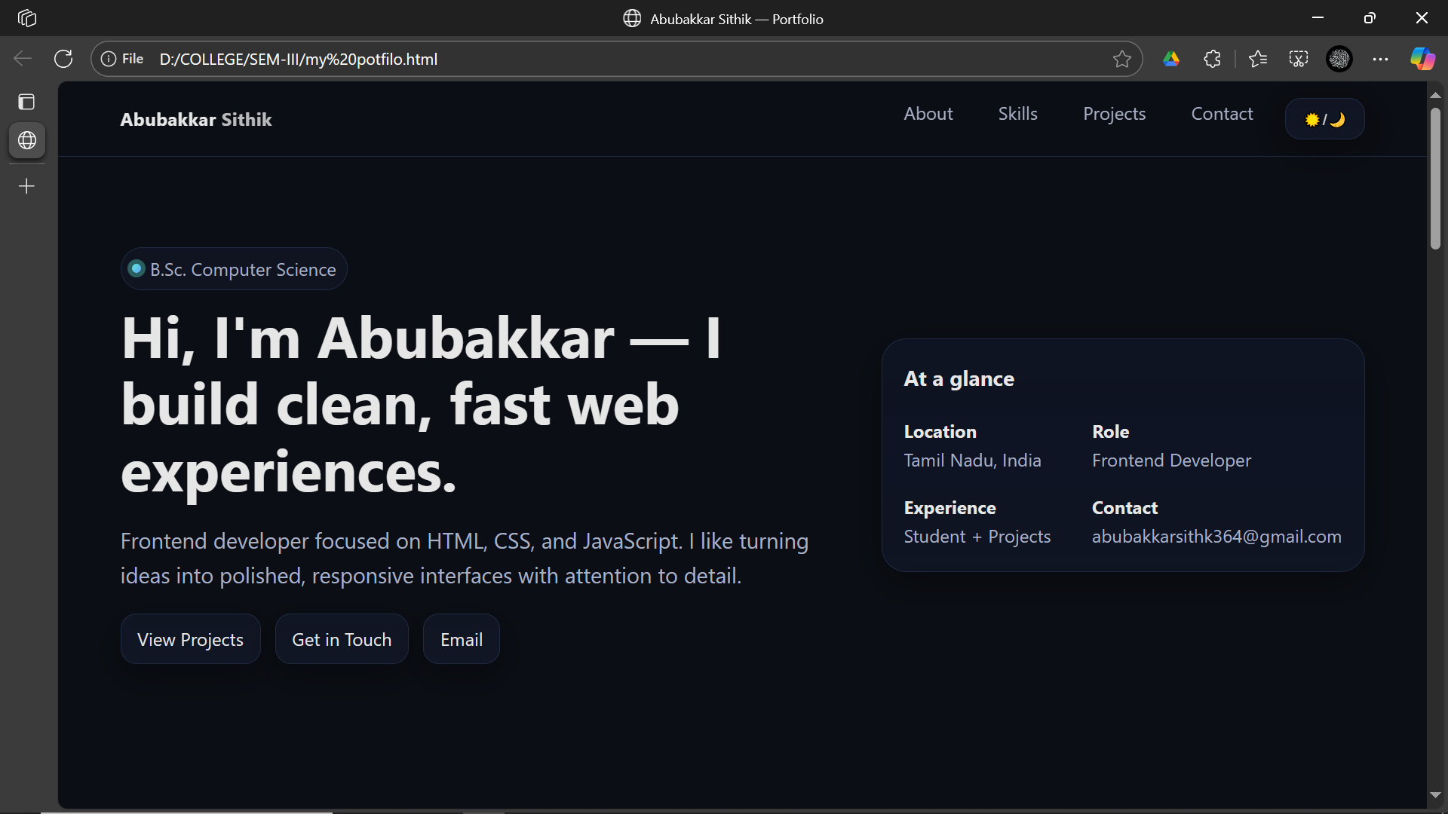

RESULTS AND SCREENSHOTS
3/21/2024 Annual Review
10

Slide 11
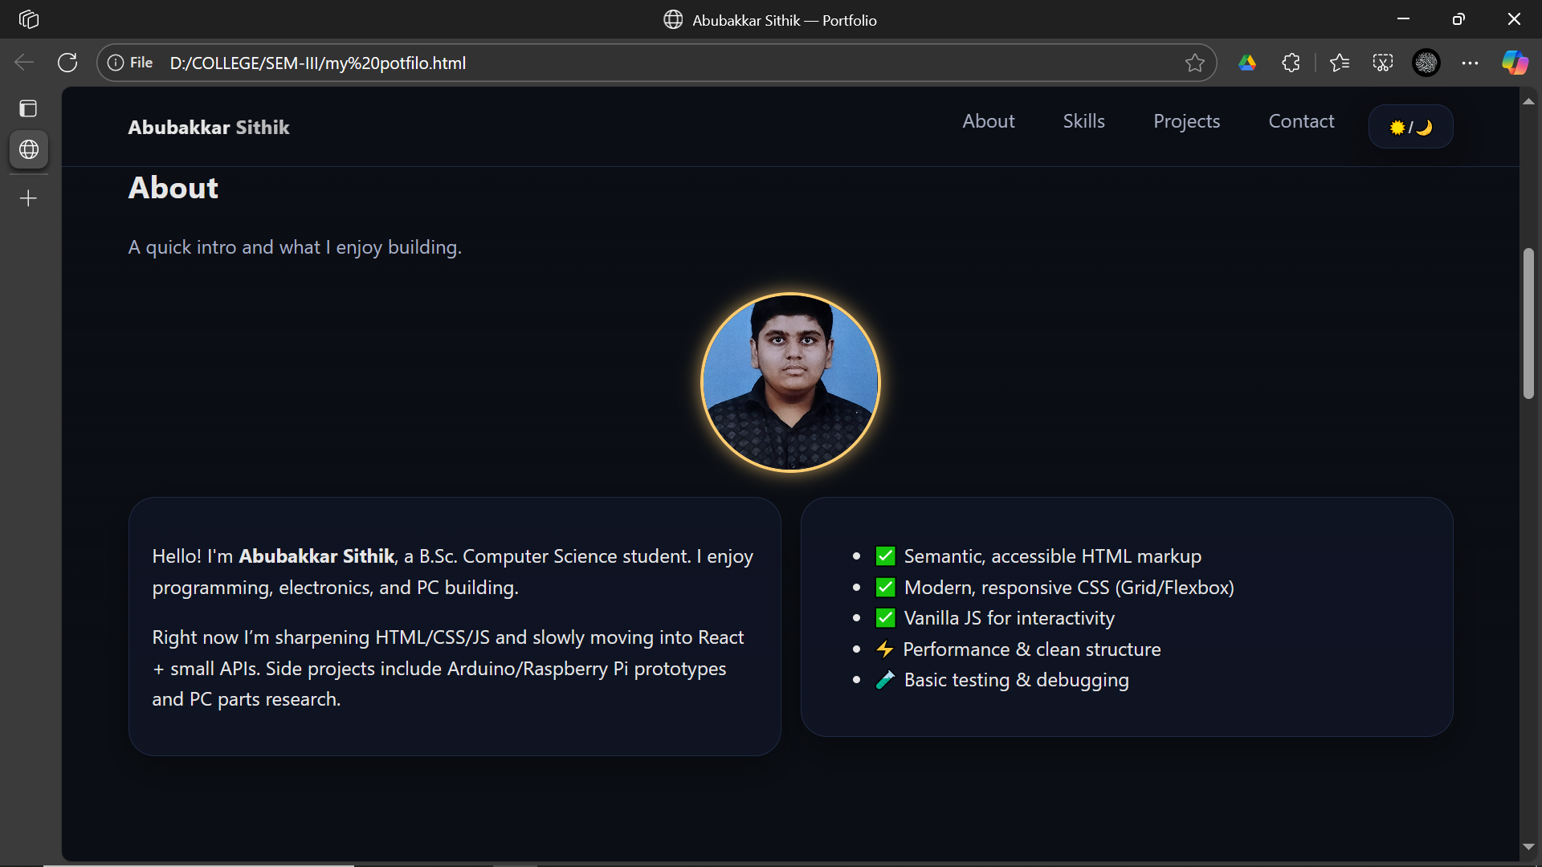
RESULTS AND SCREENSHOTS

Slide 12
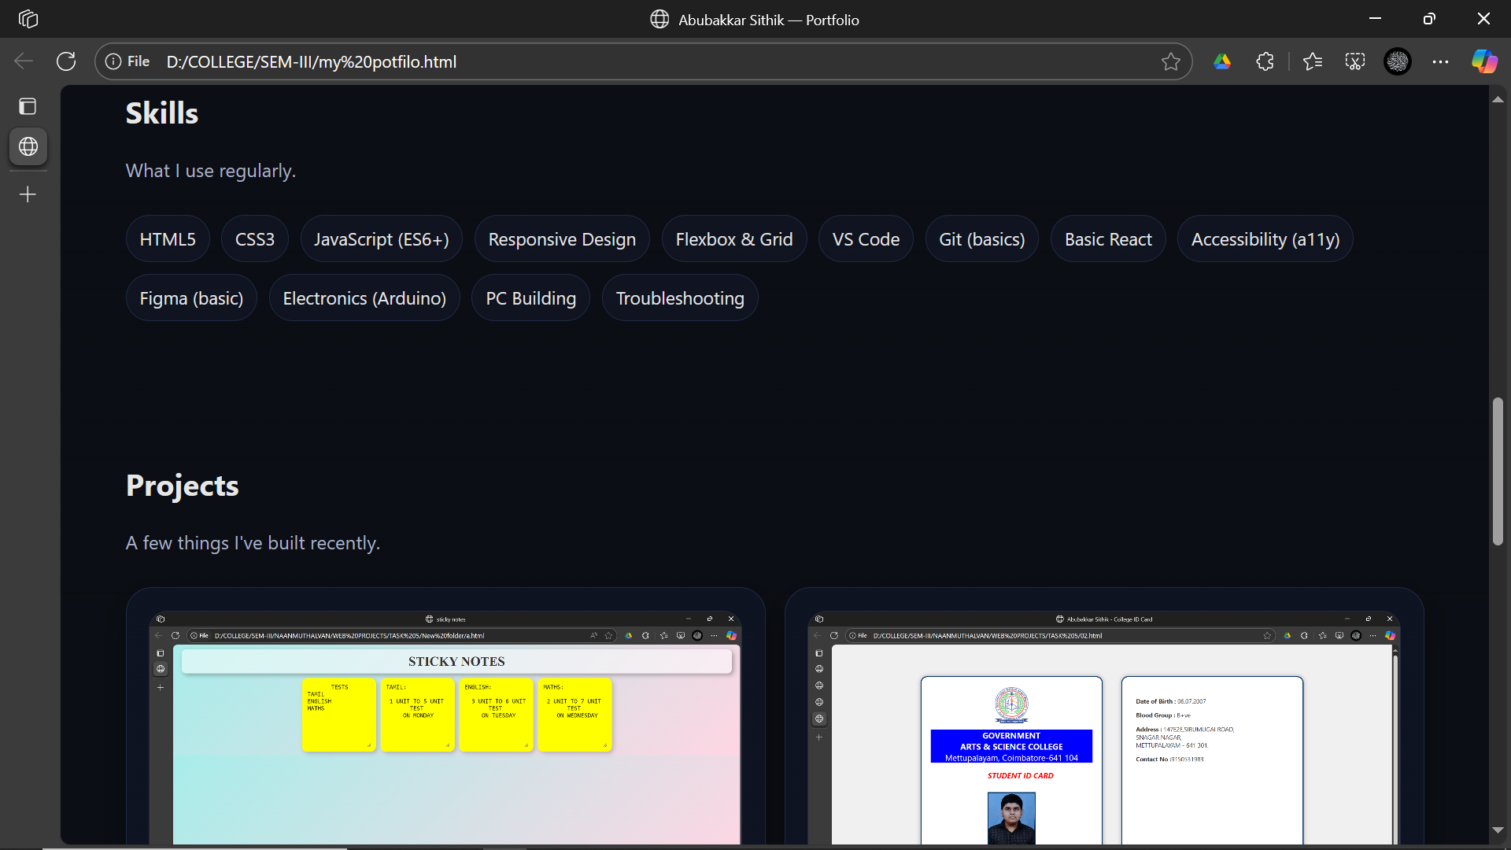
RESULTS AND SCREENSHOTS

Slide 13
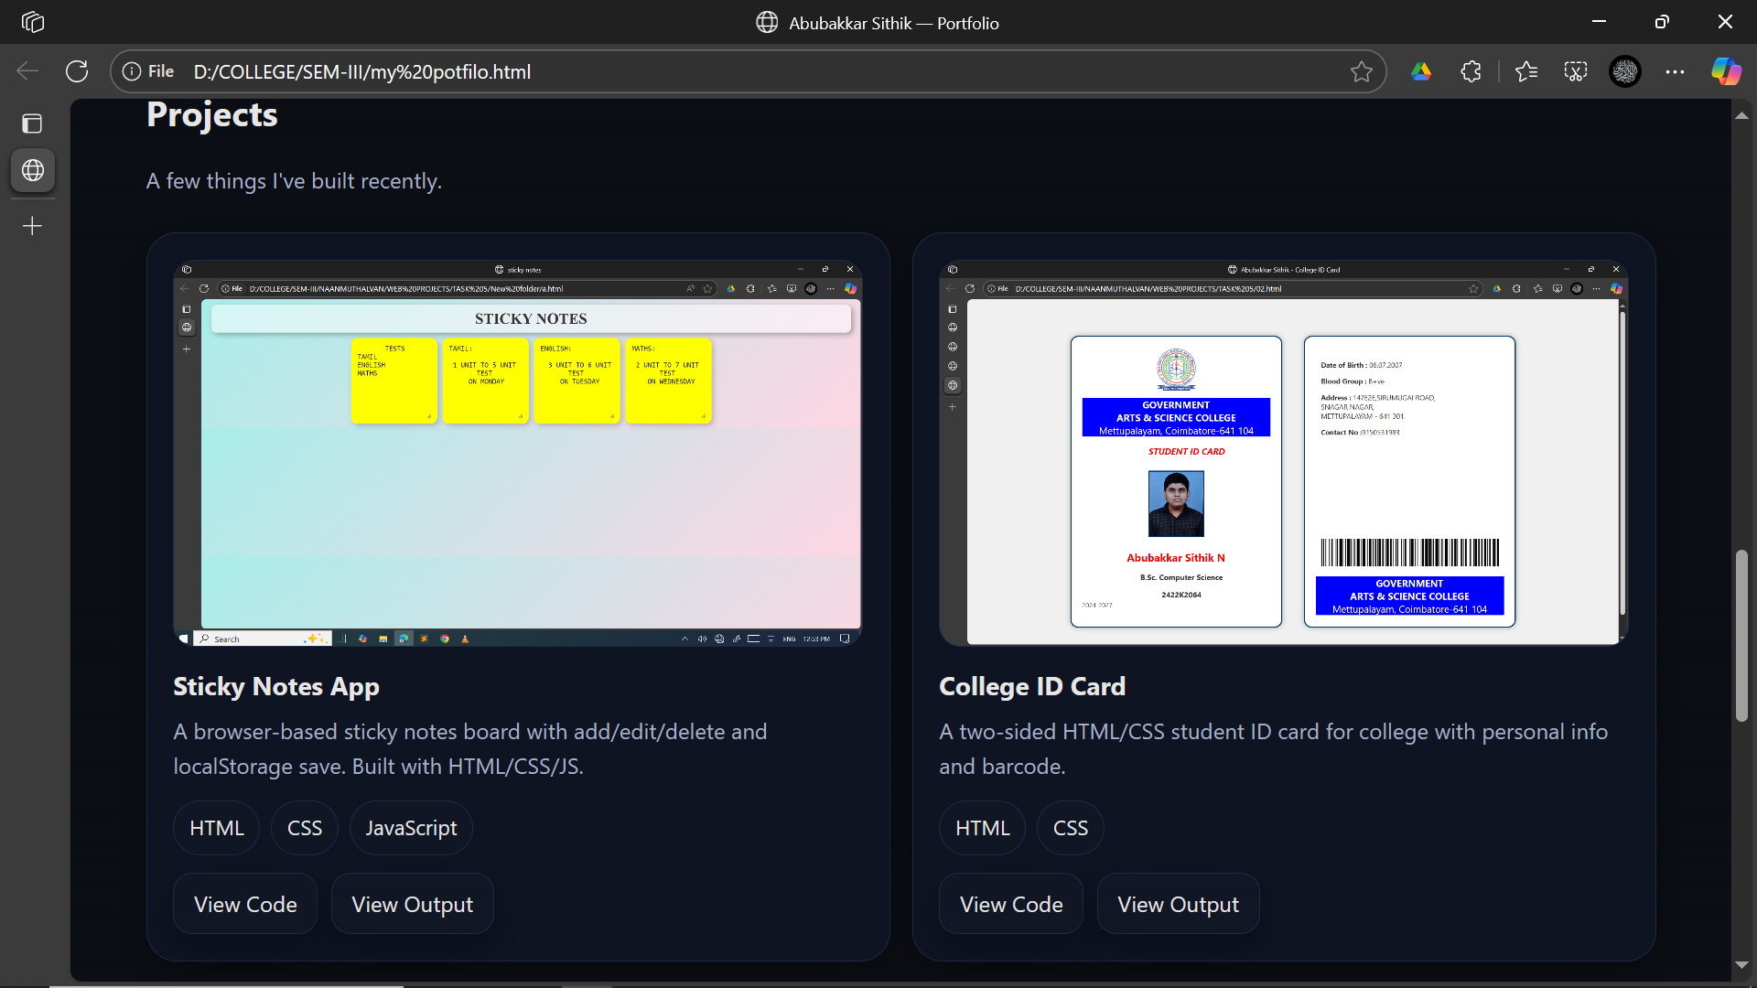
RESULTS AND SCREENSHOTS

Slide 14
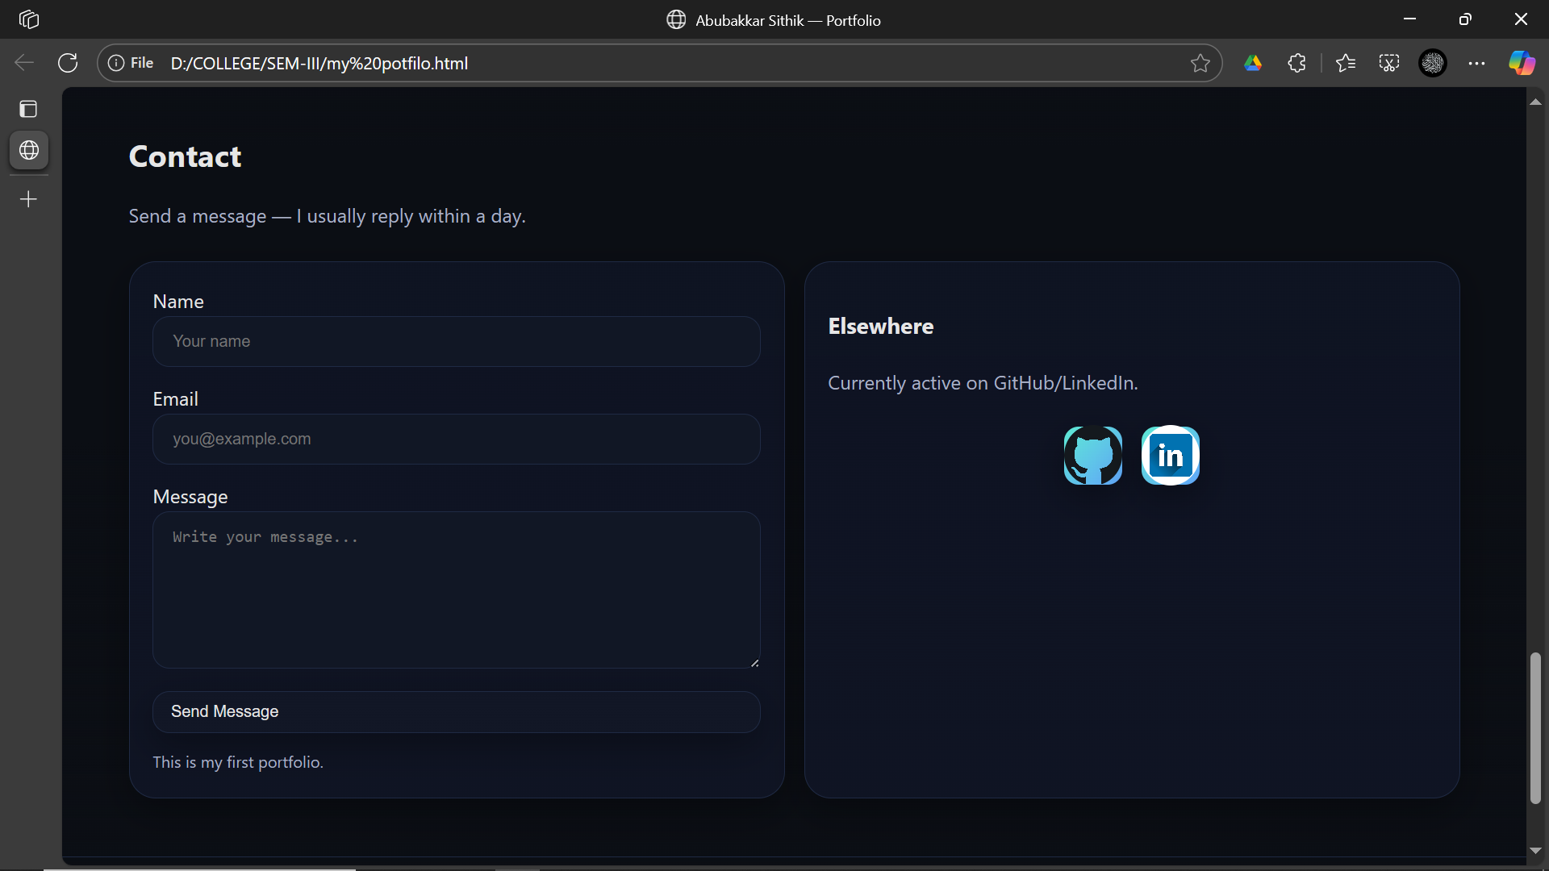
RESULTS AND SCREENSHOTS

Slide 15
CONCLUSION
The portfolio serves as a personal branding tool for abubakkar sithik N.
It highlights technical skills, projects, and interests in a professional way.
The website is a foundation that can be expanded with more projects, blogs, or case studies in the future.
15

